Slide 1

RISHITA CHOUHAN
EXPLORATORY DATA ANALYSIS-C6
September 09, 2022
NIIT

Slide 2

BRAZIL HOUSING
Castro Brazila Inc.

Slide 3



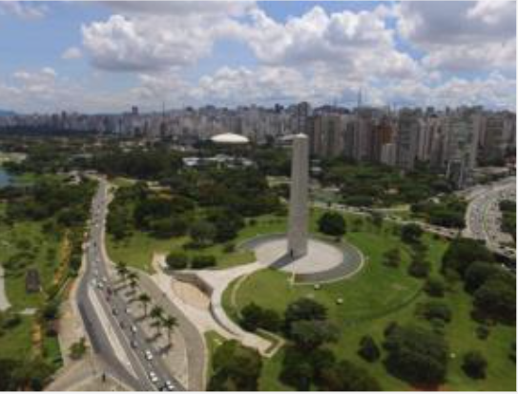

Introduction
Rio De Janeiro and São Paulo are among the most expensive cities in Brazil to live in.
TASK :-
Many people from these cities are considering relocating to a different city to live in and work remotely. Castro Brazila Inc., a top real estate management firm with a nationwide presence in Brazil,wants to help people choose an alternate city to relocate.

Slide 4
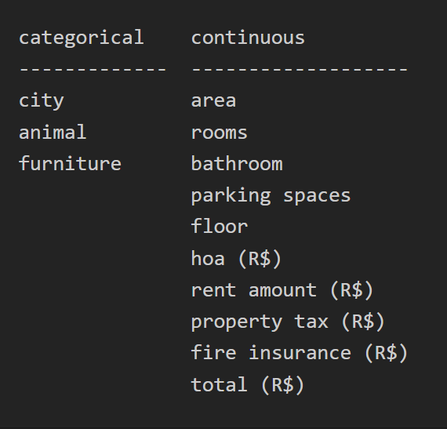
DATA
COLUMNS IN THE DATA

Slide 5
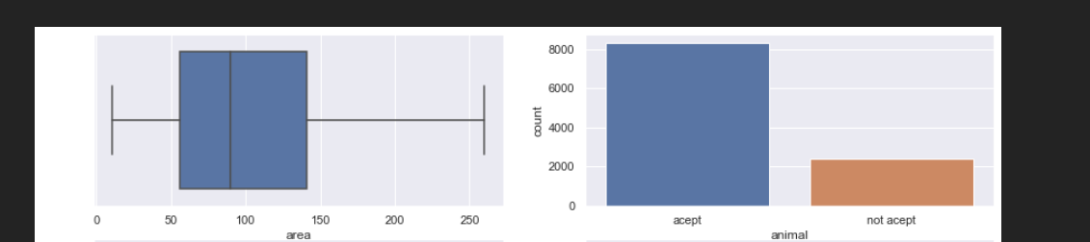
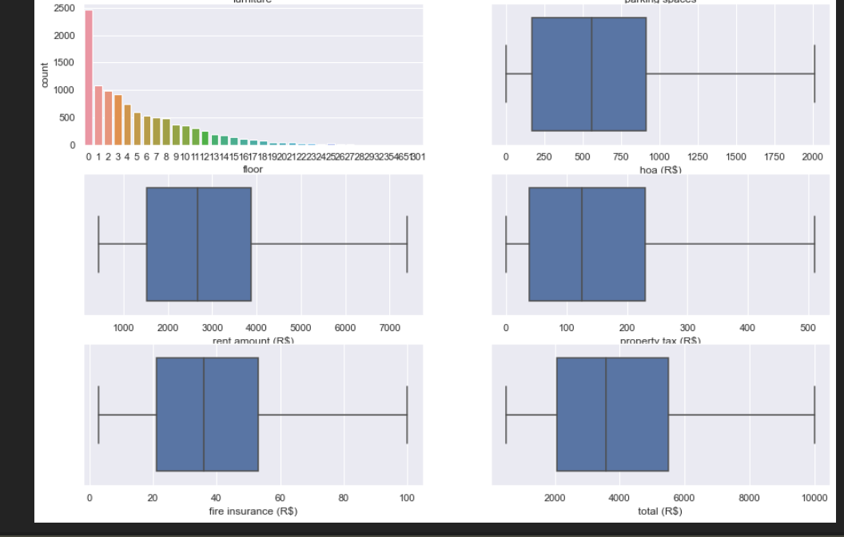
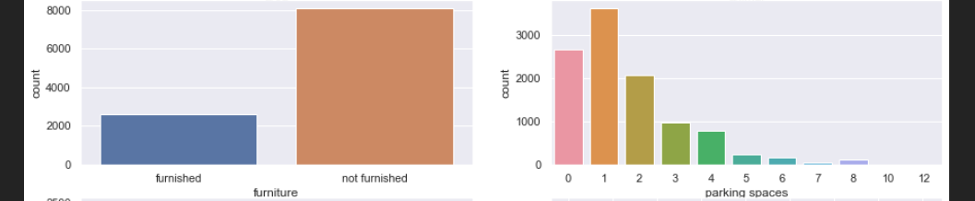
𝑈𝑛𝑖𝑣𝑎𝑟𝑖𝑎𝑡𝑒 𝐴𝑛𝑎𝑙𝑦𝑠𝑖𝑠 𝑜𝑓 𝑁𝑢𝑚𝑒𝑟𝑖𝑐𝑎𝑙 𝑉𝑎𝑟 (After outlier treatment)

Slide 6
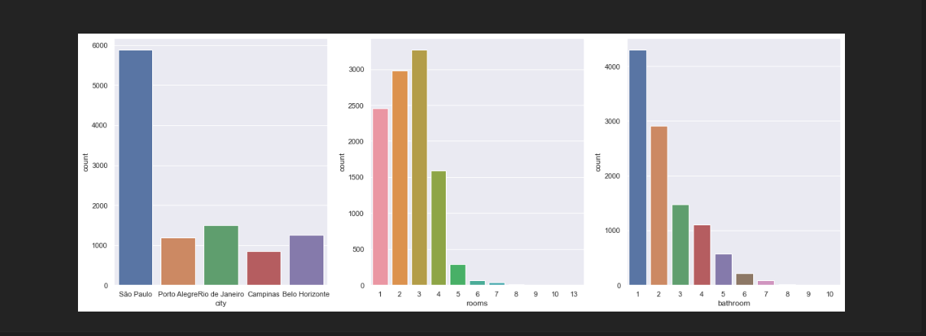
𝑈𝑛𝑖𝑣𝑎𝑟𝑖𝑎𝑡𝑒 𝐴𝑛𝑎𝑙𝑦𝑠𝑖𝑠 𝑜𝑓 𝐶𝑎𝑡𝑒𝑔𝑜𝑟𝑖𝑐𝑎𝑙 𝑉𝑎𝑟𝑖𝑎𝑏𝑙𝑒𝑠
CONCLUSION
These plots involve all the cities and characteristics of a single column in the data
For better analysis we need to relate these features and see which see is better to live in

Slide 7
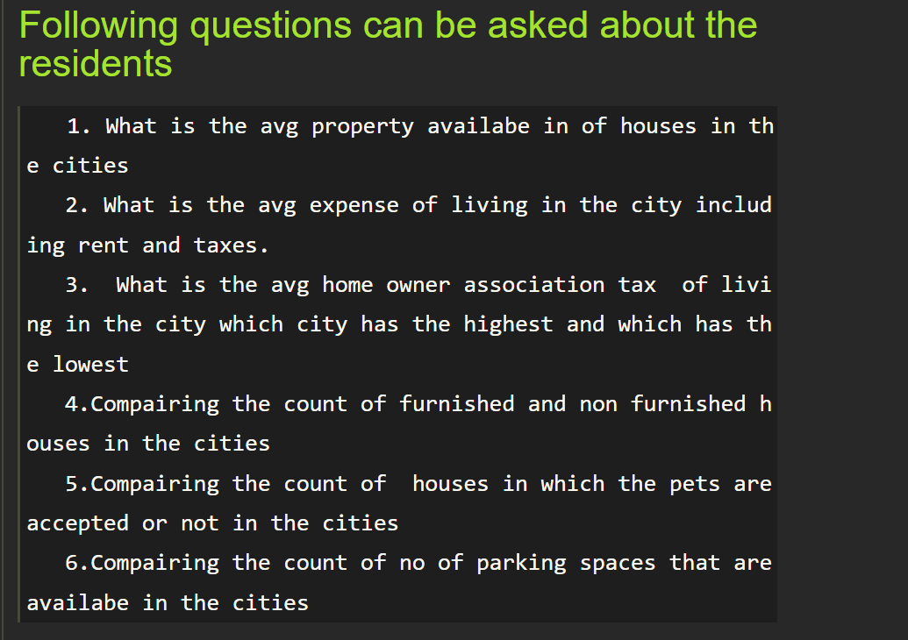
BIVARIATE ANALYSIS

Slide 8
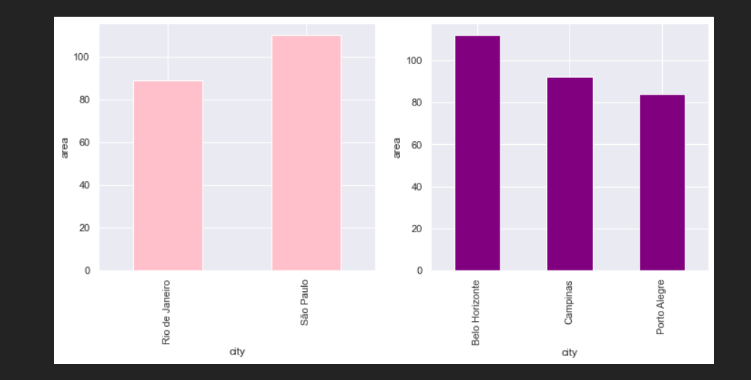
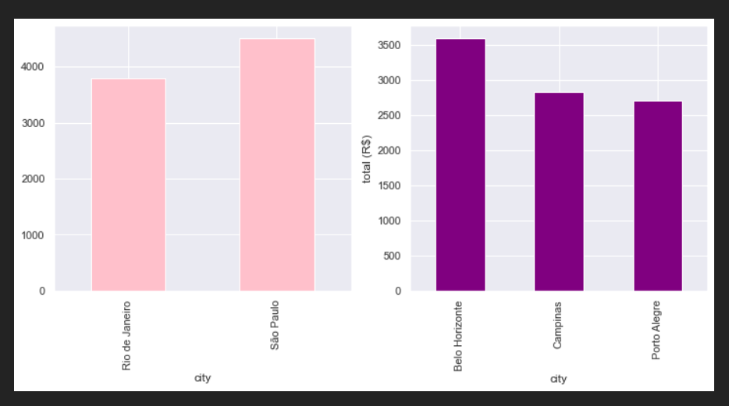
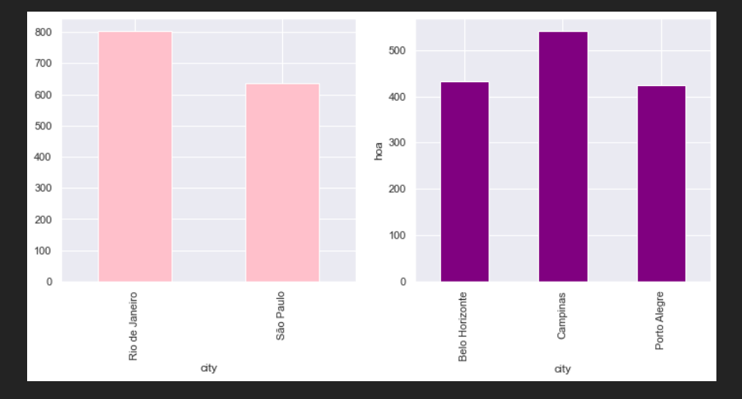
ANALYSIS
AREA VS CITY
TOTAL VS CITY
CITY WITH THE MAX EXPENSE ID BELO HORIZONTE AND MIN EXPENSE IS OF PORTO ALEGRA
MAX AREA IN THE CITIES IS BELO HORIZONTE

Slide 9
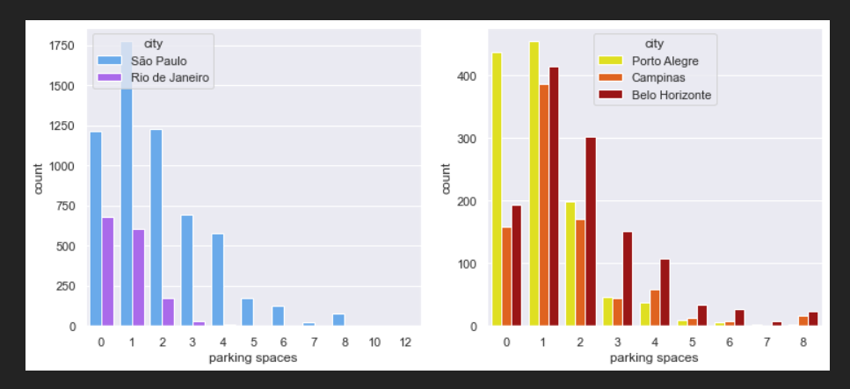
CITY THAT HAS MAX AVG HOA IS CAMPIANA
HOA VS CITY
COUNT OF PARKING SPACES VS CITY
IN ALL THE CITIES MAX HOUSES ARE NOT FURMISHED BUT IF THE FAMILY IS LOOKING FOR FURNISHED HOUSES THAT PORTO ALEGRA CAN BE GOOD OPTION

Slide 10
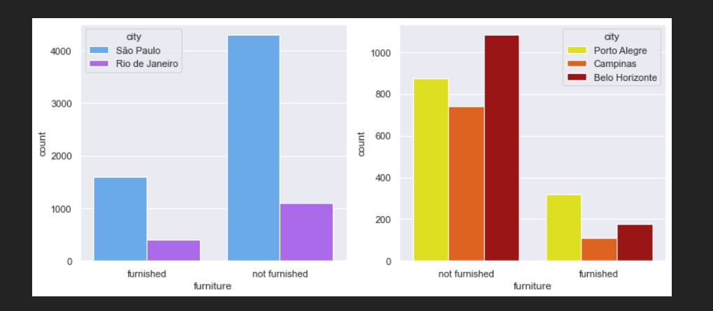
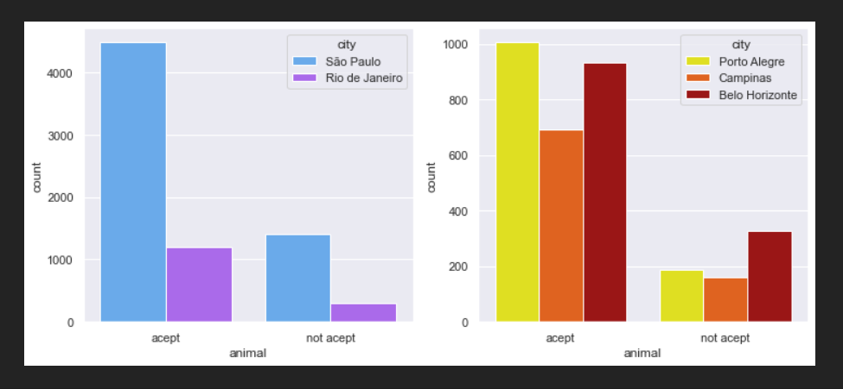
COUNT OF FURNITURE COL VS CITY
COUNT OF HOUSE ON ANIMAL COL VS CITY
PORTO ALGERA IS THE CITY THAT HAS MAX COUNT OF HOUSES THAT ACCEPT ANIMALS SO THIS CITY CAN BE A GOOD CHOICE FOR FAMILY WITH PETS
MAX PARKING SPACES AVAILABE ARE FOR ONE CAR HAVING MAX
COUNT IS PORTO ALGERE

Slide 11
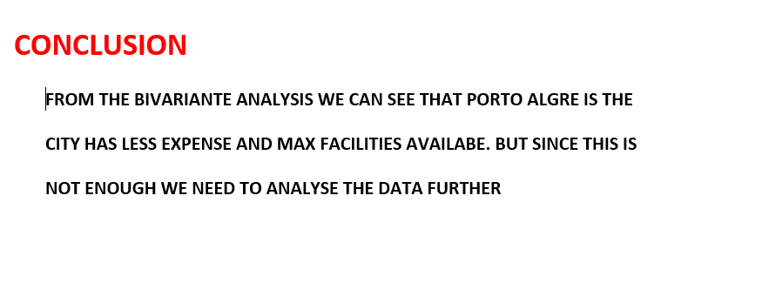

Slide 12
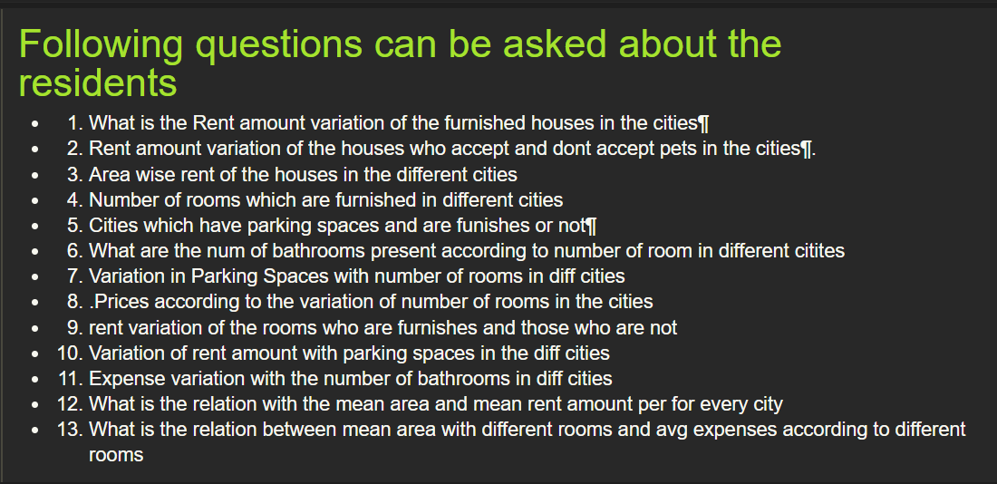
Multivariate analysis

Slide 13
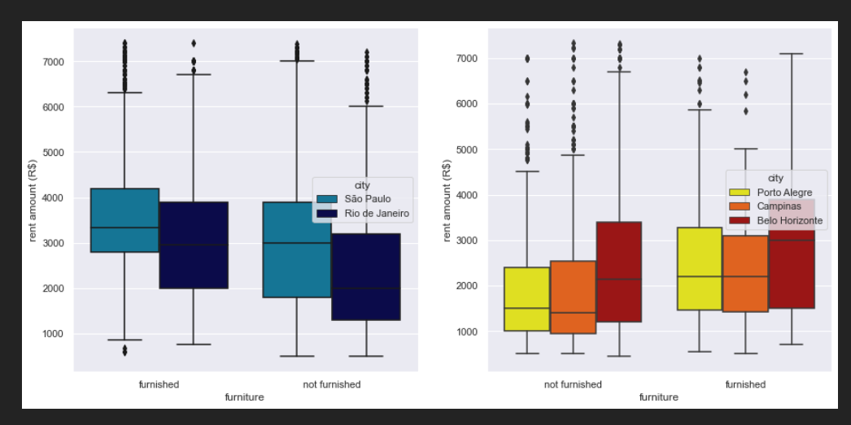
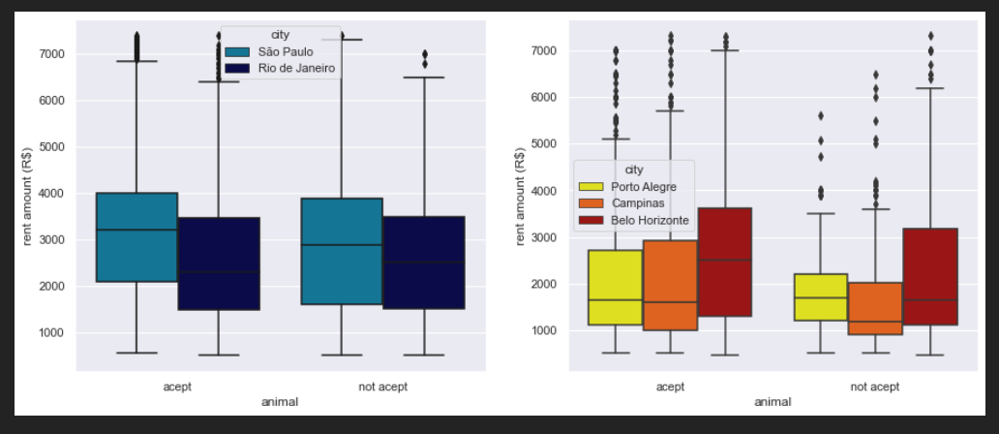
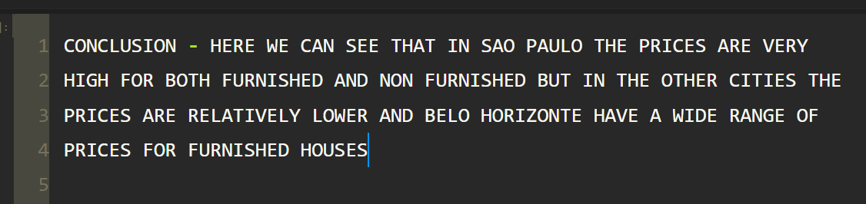
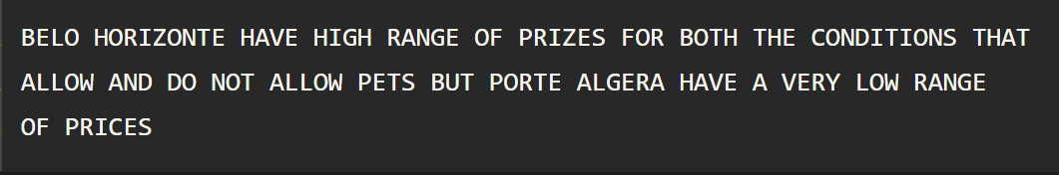
Multivariate
Rent amt vs furniture
Rent amt vs animal

Slide 14
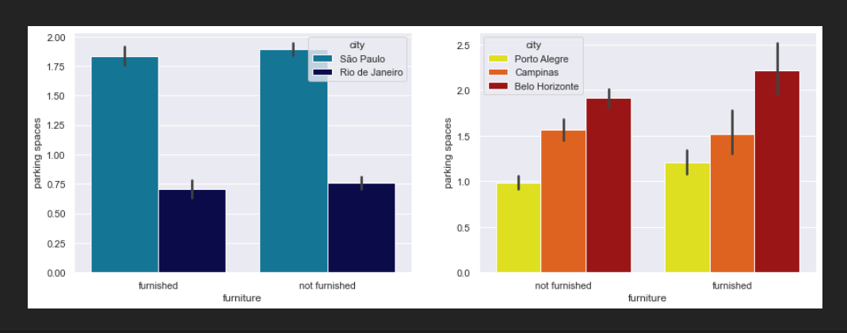
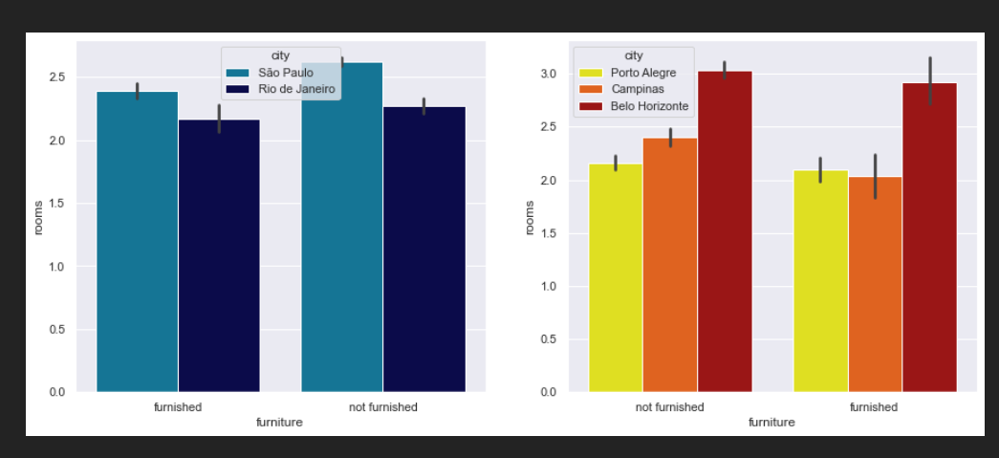
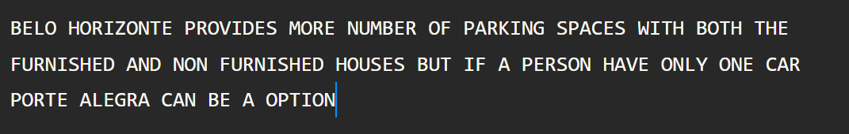
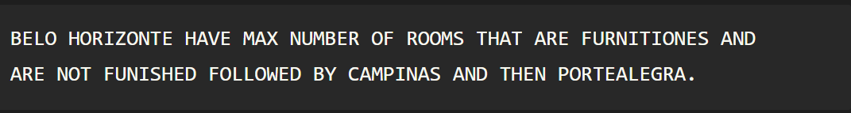
Parking spaces vs furniture
Num of rooms vs furniture

Slide 15
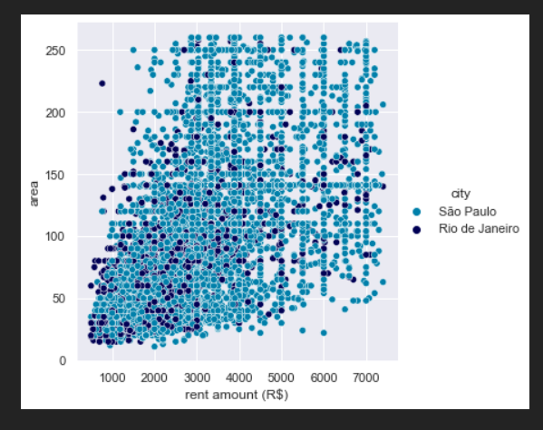
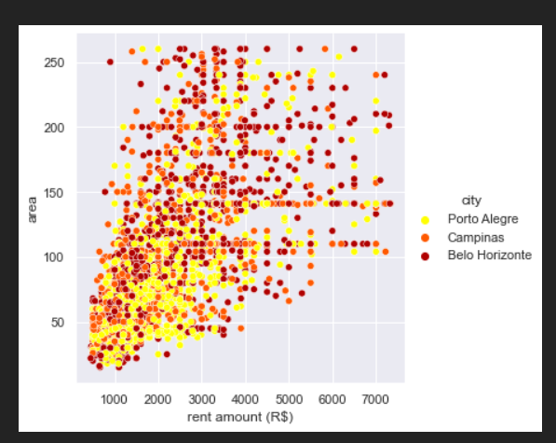
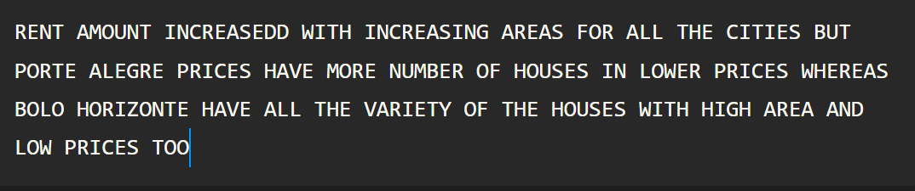
Rent amount vs area

Slide 16
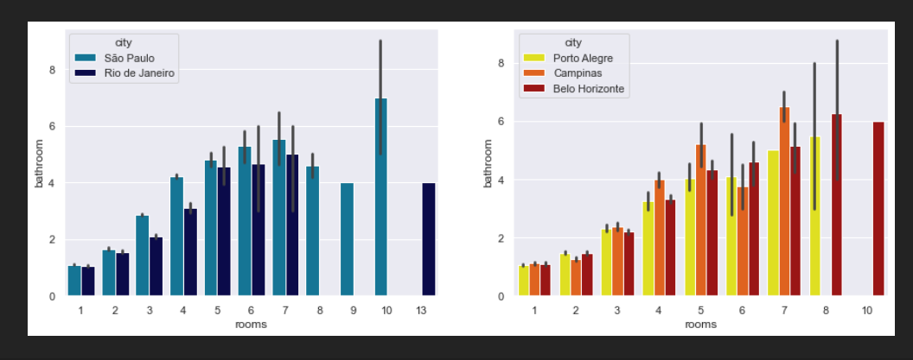
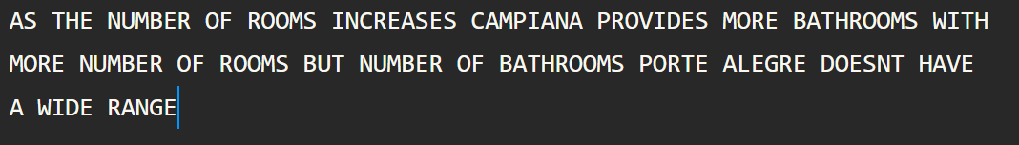
Rooms vs bathrooms

Slide 17
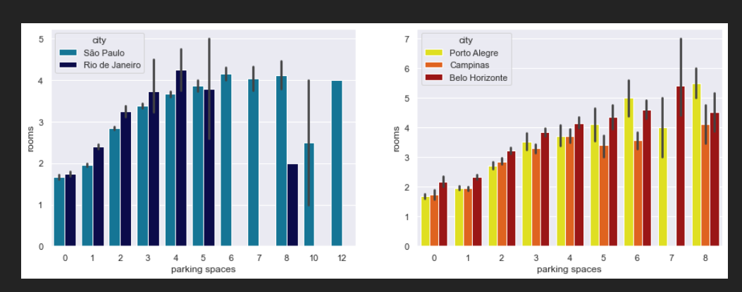
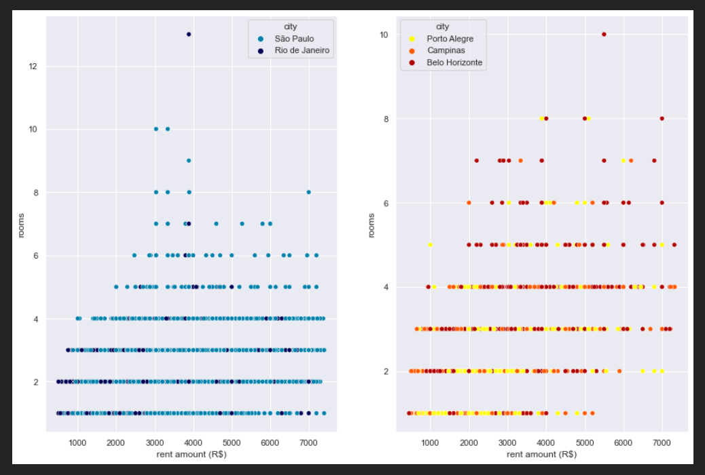
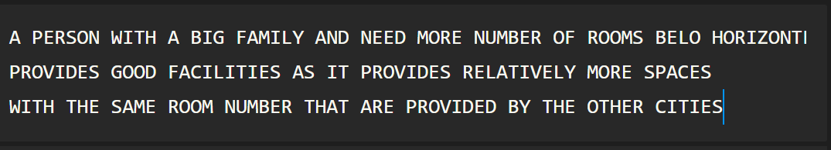
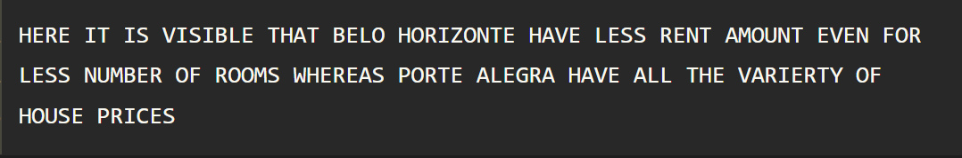
Parking spaces vs rooms
Rent amt vs rooms

Slide 18
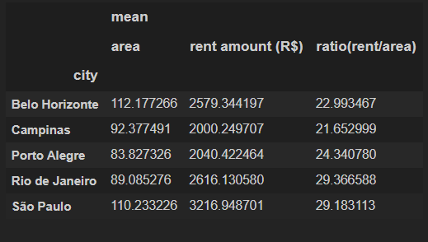
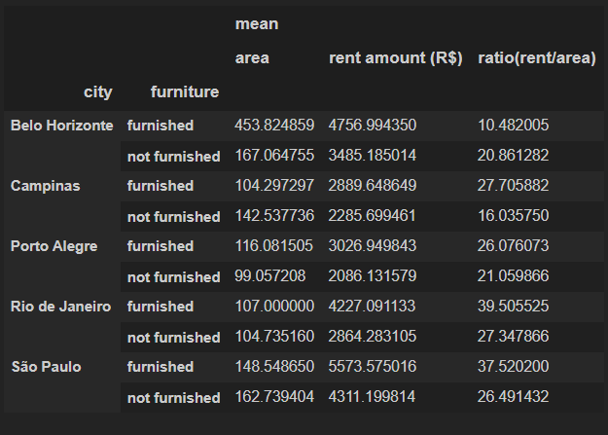

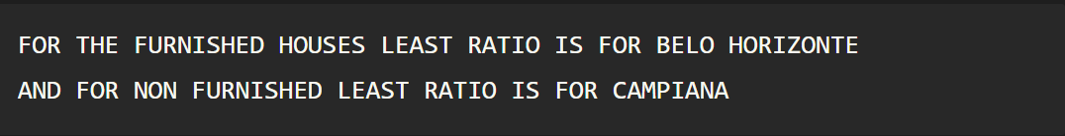
Mean(area) vs rent amount
Furniture(mean area) and hoa

Slide 19
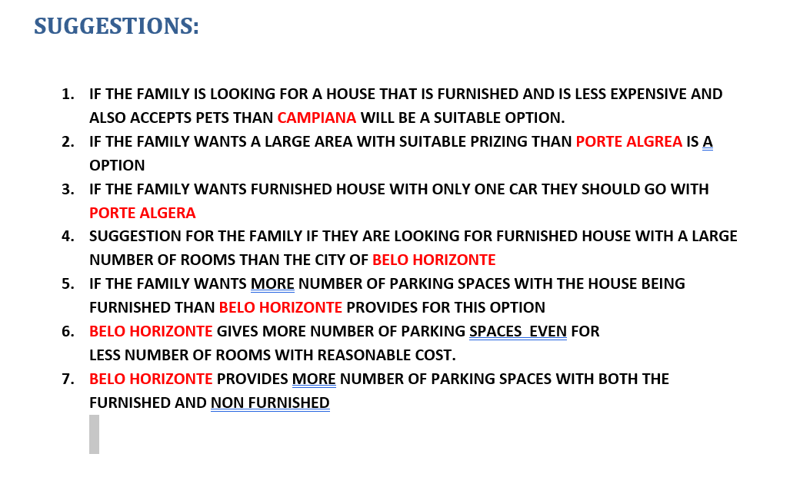

Slide 20

THANK YOU

